Slide 1

KNU 2021-1 Capstone Design Project 2 – 고석주 교수님
3.16 발표자료
AI-Tube
과제명 : 인공지능을 이용하여 text 기반 동영상 편집 앱, AiTube 개발
(Development of a text-based video editing app, AiTube using artificial intelligence)
Team 11 2014016014 오강산
2015111931 유대용
2018113830 편예린
2014097026 김태욱

Slide 2
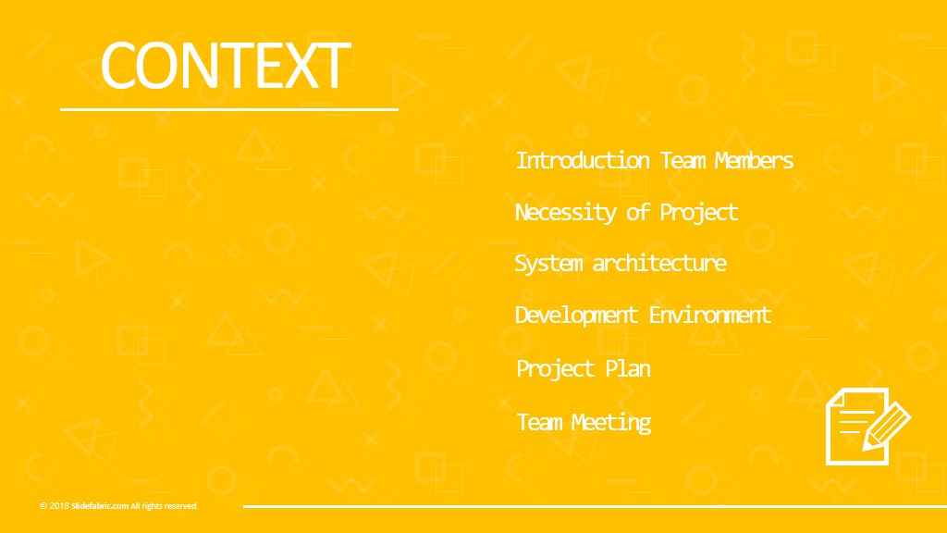
CONTEXT

Slide 3
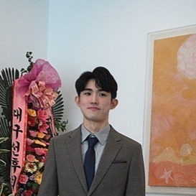

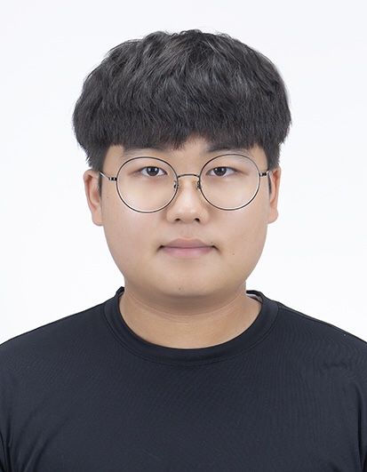
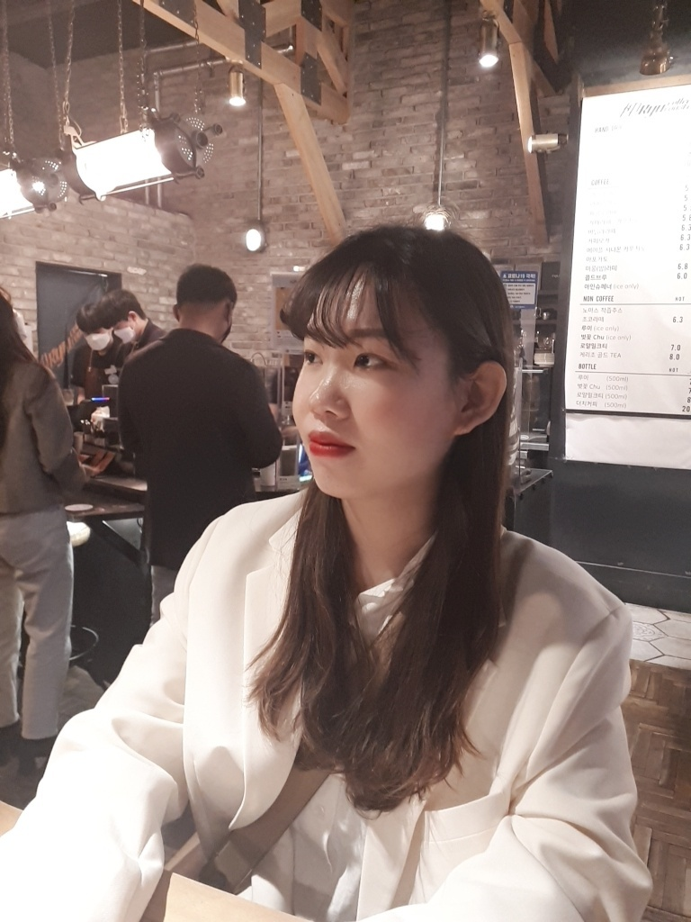
Introduction Team Members
Kangsan O
Role : leader,
json parsing
Daeyong Ryu
Role : ffmpeg algorithm optimization
Taeuk Kim
Role : ffmpeg algorithm optimization
Yerin Pyeon
Role : API server development

Slide 4
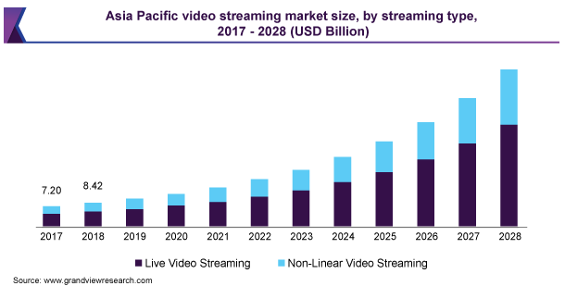
Necessity of Project​
Increasing video streaming market size
유투부 지분율
편집 툴 많아짐에 따라 사용자 피로 증대
쉬운 툴 필요

Slide 5


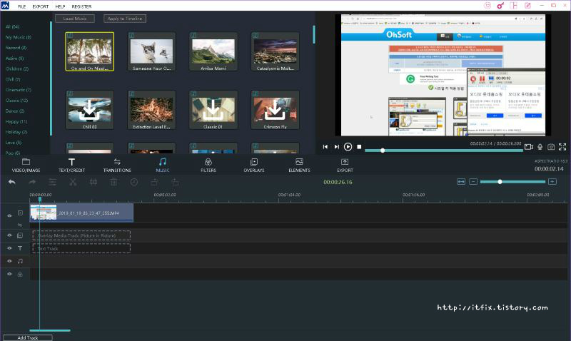


Necessity of Project​
Problems with existing programs
Timeline-based editing
Requires simpler, more intuitive programs
유투부 지분율
편집 툴 많아짐에 따라 사용자 피로 증대
쉬운 툴 필요

Slide 6
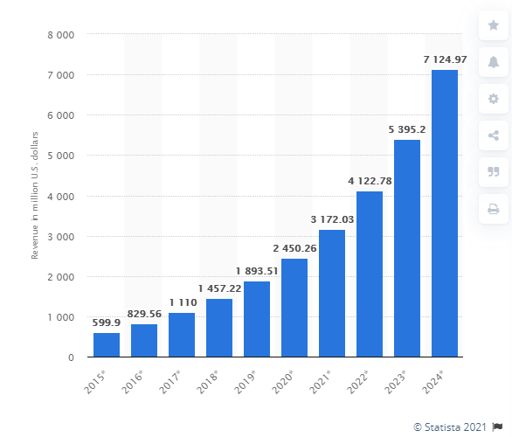
Necessity of Project​
Increasing of the voice and speech recognition technology
Size of the voice and speech recognition technology market worldwide, from 2015 to 2024
유투부 지분율
편집 툴 많아짐에 따라 사용자 피로 증대
쉬운 툴 필요

Slide 7
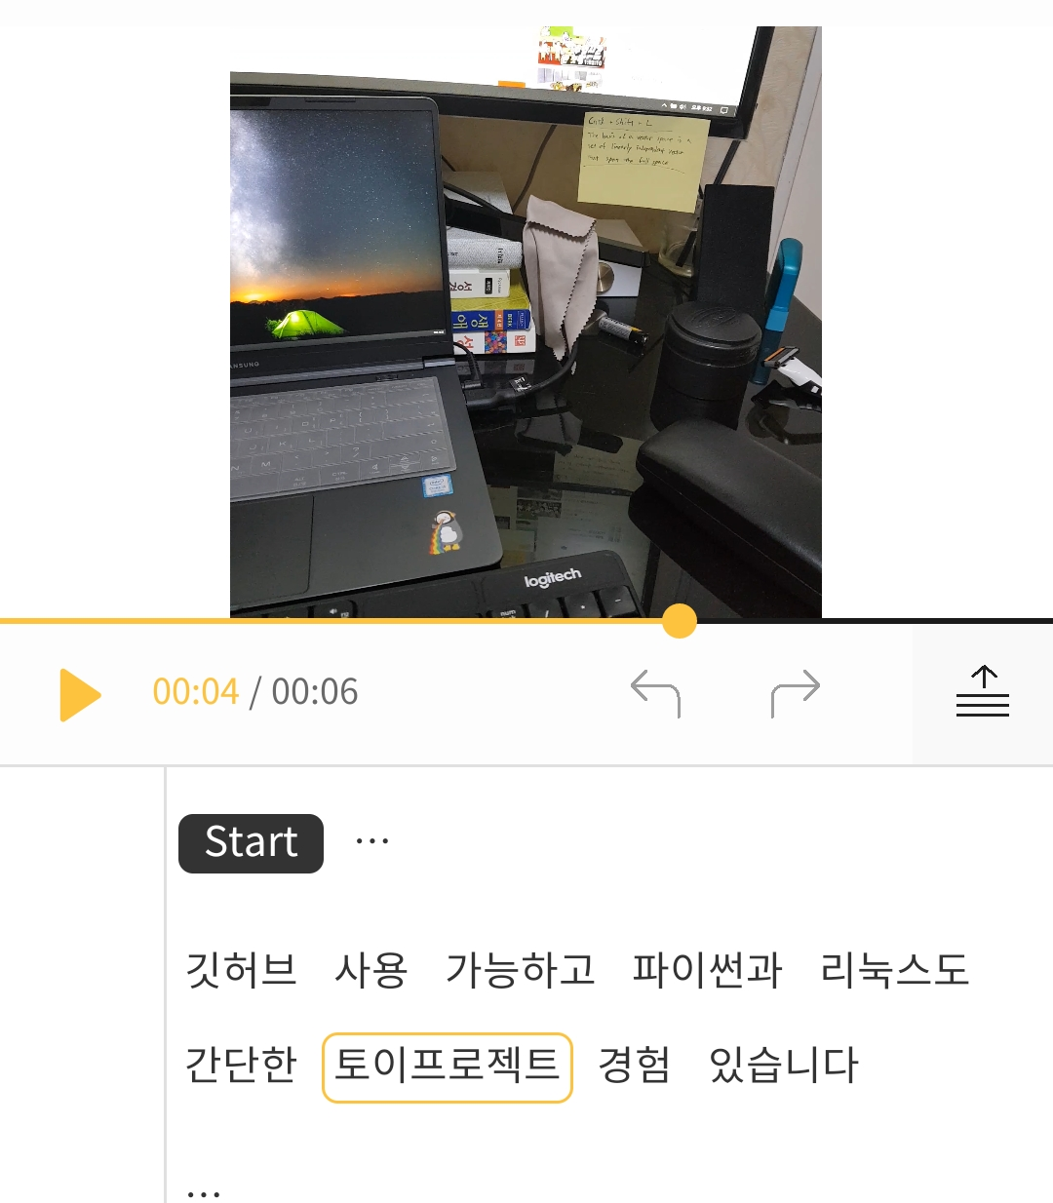
Necessity of Project​
Solutions to the new programmes
STT-based editing in mobile environment
유투부 지분율
편집 툴 많아짐에 따라 사용자 피로 증대
쉬운 툴 필요

Slide 8
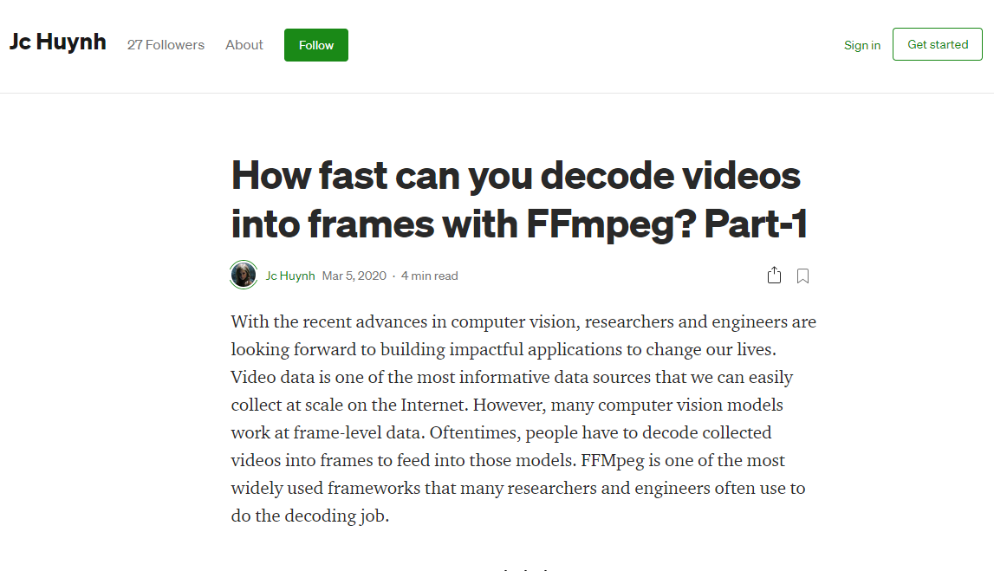
Necessity of Project​
Performance issue
Requires ffmpeg optimization
유투부 지분율
편집 툴 많아짐에 따라 사용자 피로 증대
쉬운 툴 필요

Slide 9
System architecture
Client
Editing history
Video file
Video resource
Server
ffmpeg
Video editing
Decoding
Encoding
Result file

Slide 10
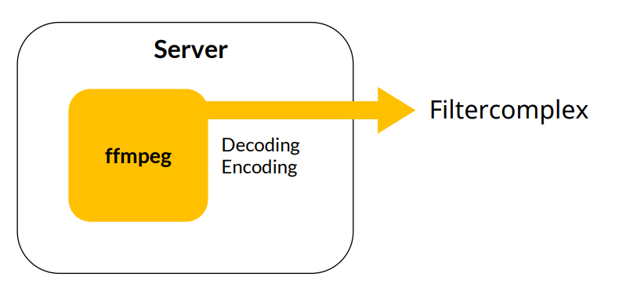
System architecture
Optimization = Minimizing file I/O

Slide 11





Development Environment
Framework
Library
Later development

Slide 12
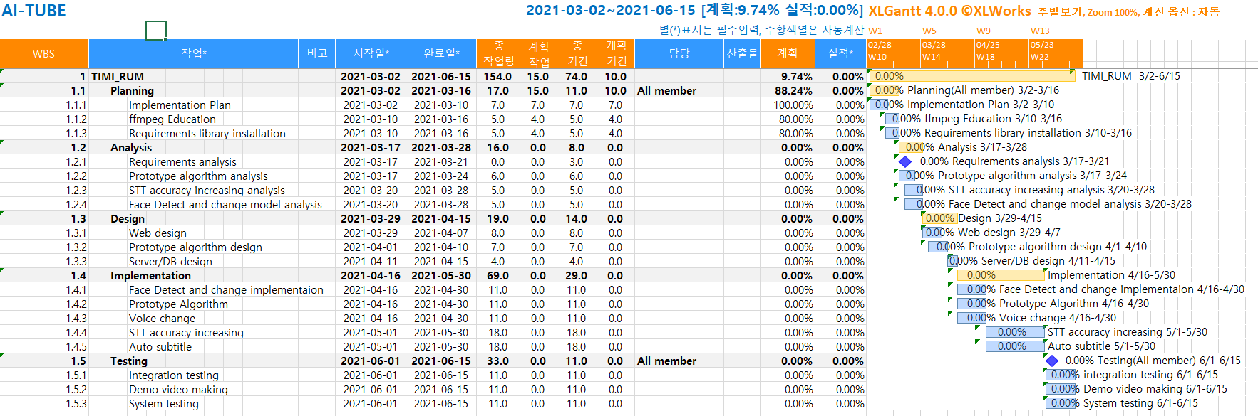
Project Plan

Slide 13
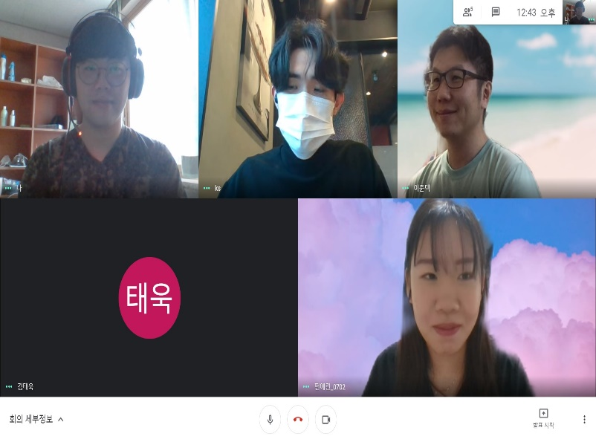
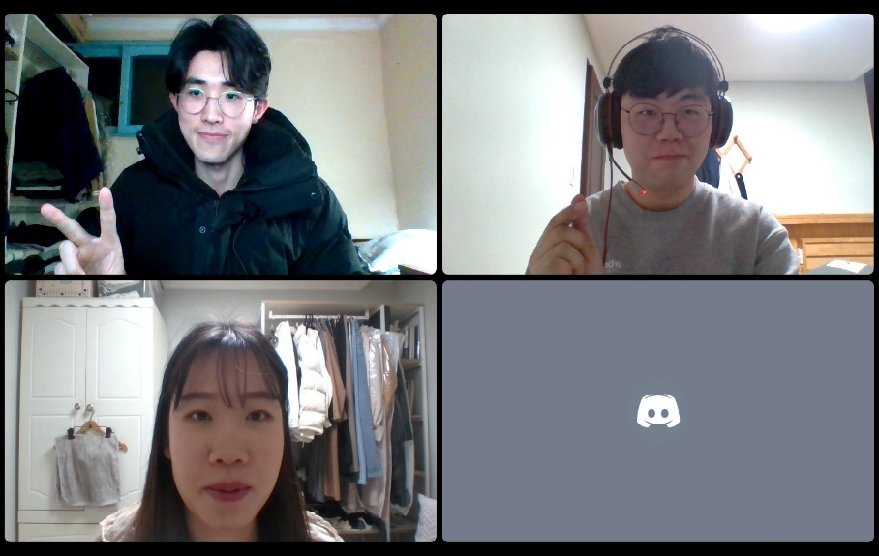
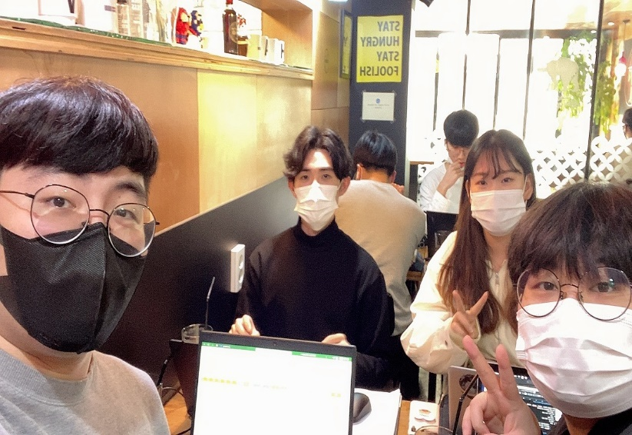
Team meeting
Google Meeting
Discord
offline Meeting
2021-03-12
2021-03-13
2021-03-15

Slide 14

THANKS

Slide 15
Source
Size of the voice and speech recognition technology market worldwide, from 2015 to 2024
https://www.statista.com/statistics/608523/worldwide-voice-speech-recognition-software-market/
Increase streaming market size article
https://www.grandviewresearch.com/industry-analysis/video-streaming-market
ffmpeg article
https://medium.com/@jchuynh/how-fast-can-you-decode-videos-into-frames-with-ffmpeg-part-1-d12a267f9b13
Screenshot of moviemaker
https://itfix.tistory.com/175

